Slide 1
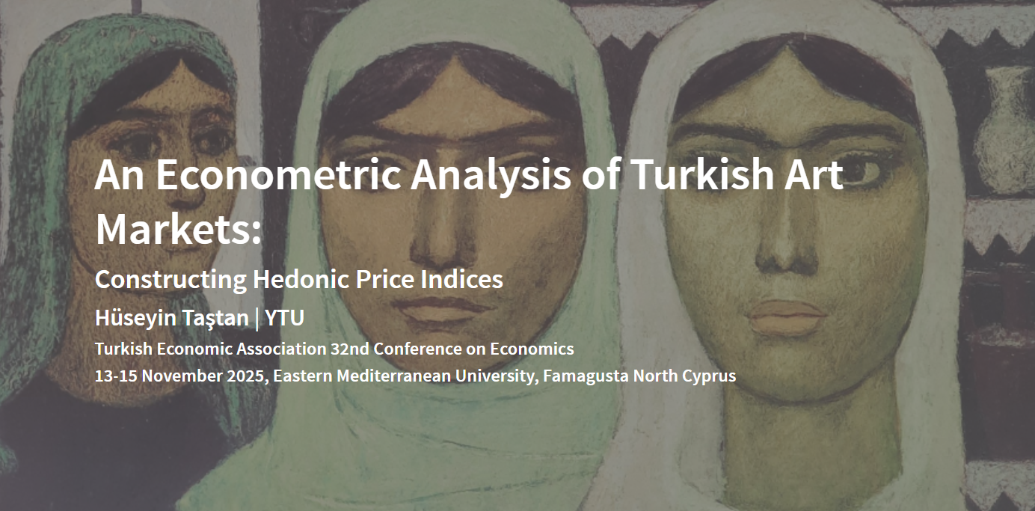

Slide 2
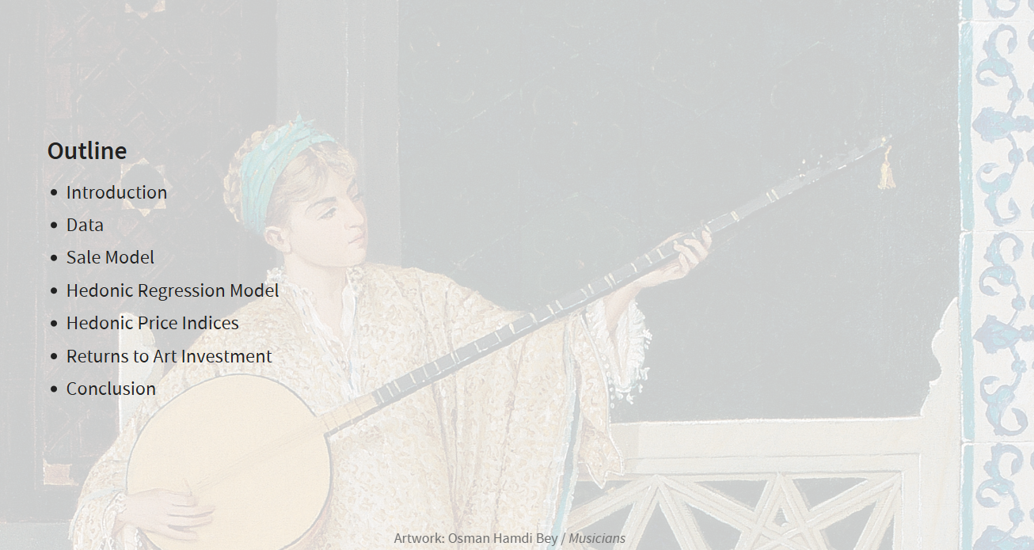

Slide 3
Introduction
Research Focus
This study examines Turkish art markets through two econometric lenses:
Liquidity dimension:
What characteristics predict whether an artwork sells?
How do sale probabilities differ by artist prominence?
Price dimension:
What explains auction prices?
How do price determinants differ by artist prominence?
Data: Turkish paintings auction data, 1989-2020
Methods
Sale probability analysis:
Probit model of sale (1/0)
Predicts: Artwork characteristics → Sale probability
By segment: Prominent/Elite artists vs. the rest
Price analysis:
Hedonic regression of log(Sale price)
Predicts: Artwork characteristics → Price levels
Hedonic price index and return to art investments.
By segment: Prominent vs. non-prominent

Slide 4
Introduction (Overview of the literature)
Global
Early pessimistic view (1980s-1990s):
Low real returns, high volatility
Art underperforms financial assets significantly
High transaction costs and illiquidity penalties
More recently (2000-2010s):
Positive real returns but Sharpe ratios lag equities
Valuable diversification benefit: low correlation with stocks/bonds
Heterogeneous returns across segments:
Modern art outperforms contemporary (established > emerging artists)
Investment-grade (top tier, liquid, “blue-chip”) outperforms speculative (lower tier, illiquid, uncertain value) (quality premium)
Studies on Turkish art markets
Limited academic work on emerging market art; Turkish literature growing.
Based on aggregate hedonic art indices, current evidence suggests:
Small positive real returns and diversification benefits (Atukeren and Seçkin 2006)
Integration with international art markets (Atukeren and Seçkin 2012)
Underperformance vs. domestic equities but outperformance vs global aggregates (Demir et al. 2018),
Some protection during financial crises (partial hedge/safe‑haven) during crises (Öztürkkal and Togan-Eğrican 2020)
No examination of quality stratification/market segmentation within Turkish paintings auction market

Slide 5
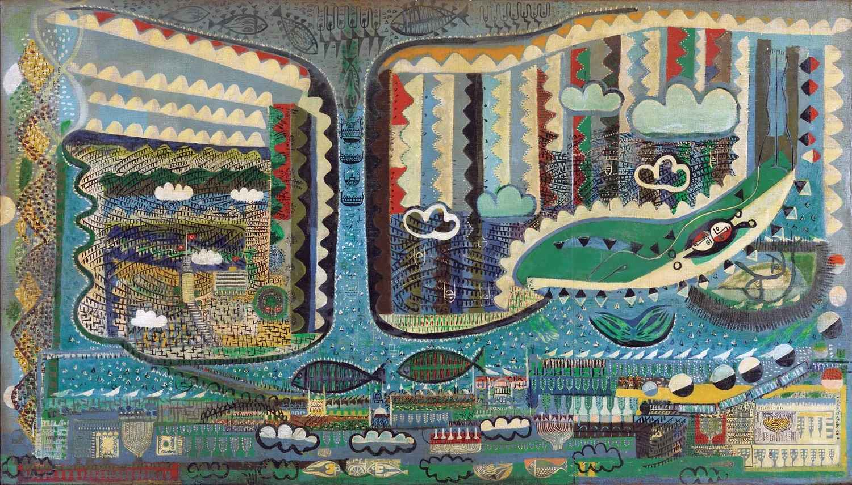
Data

Slide 6
Dataset Overview
Source and span
Data is scraped from the www.lebriz.com which maintains a comprehensive archive of art auctions.
Discontinued in 2023, but contains data spanning 1990s to 2020
We focus on paintings only (exclude sculpture, lithography, editions, etc.)
Transaction level data on auction items
Not repeat sales
Variables and content
Artist name, auction house, auction date
Artwork characteristics: dimensions (width and height), type of paintings (oil on canvas, watercolor on paper, oil on wood, acrylic on canvas, etc.), whether signed or not,
Opening prices (contains missing values)
Sale prices (in TL and USD) if sold (hammer price)

Slide 7
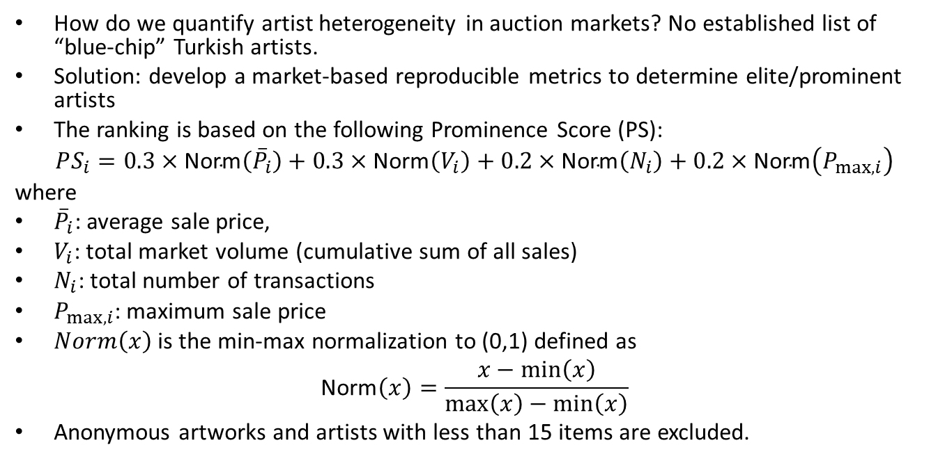
Artists
How do we quantify artist heterogeneity in auction markets? No established list of “blue-chip” Turkish artists.
Solution: develop a market-based reproducible metrics to determine elite/prominent artists
The ranking is based on the following Prominence Score (PS):
$$PS_{i}=0.3×\text{Norm}\left({\overset{‾}{P}}_{i}\right)+0.3×\text{Norm}\left(V_{i}\right)+0.2×\text{Norm}\left(N_{i}\right)+0.2×\text{Norm}\left(P_{max,i}\right)$$
where
${\overset{‾}{P}}_{i}$: average sale price,
$V_{i}$: total market volume (cumulative sum of all sales)
$N_{i}$: total number of transactions
$P_{max,i}$: maximum sale price
$Norm\left(x\right)$ is the min-max normalization to (0,1) defined as
$$\text{Norm}\left(x\right)=\frac{x−min\left(x\right)}{max\left(x\right)−min\left(x\right)}$$
Anonymous artworks and artists with less than 15 items are excluded.

Slide 8
Prominent Artists
Top 100 artists are classified in the Elite/Prominent segment out of 486 unique artists.
Market Concentration:
Top 100 artists (20.5% of population) generate 79.6% of total market volume
Prominent artists command 4× higher prices and 15 pp higher sale rates
Implication: Strong market segmentation motivates separate econometric modeling by artist prominence
Note: table includes Anonymous artists and those with lots<15 (classified as nonprominent).
Segment | Artworks Offered | Sale Rate | Avg Price | Total Volume | Artists
Non-Prominent | 57,496 | 58.6% | $4,203 | $141.7M | 388
Prominent (Top 100) | 43,025 | 73.8% | $17,410 | $552.7M | 100
Total | 100,521 | 65.3% | $10,323 | $694.4M | 488
Sample composition and liquidity by artist segment (1989-2020)

Slide 9
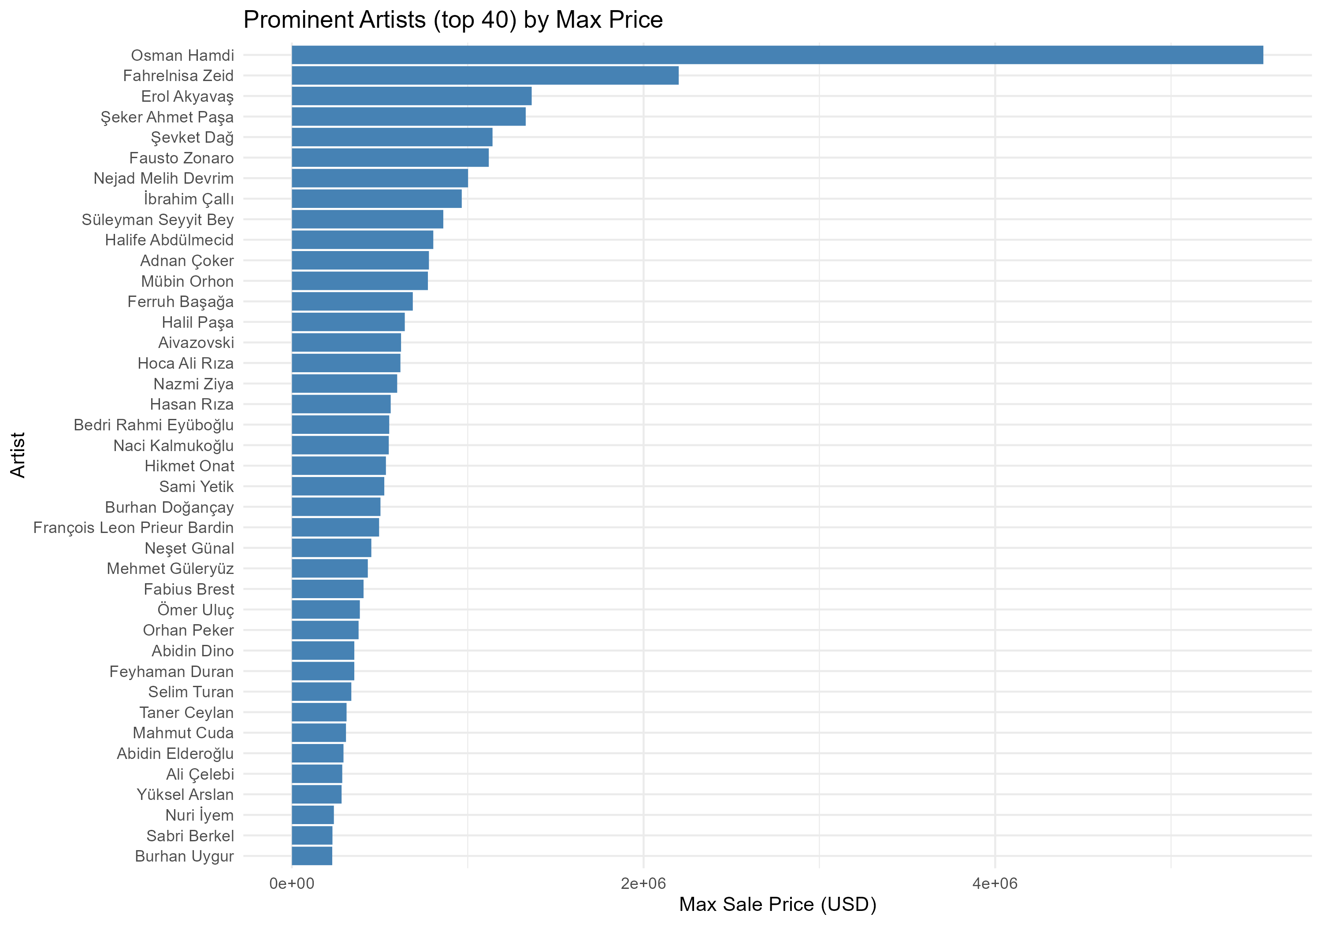
Includes both historical masters (19th/20th century) and established contemporary figures
Osman Hamdi Bey is at the top with $5.5M sale, followed by Fahrelnisa Zeid, Erol Akyavaş, Şeker Ahmet Paşa
Remaining 60 artists range $10K-220K
Among living artists, Taner Ceylan is at the top followed by Ergin İnan, Canan Tolon, Neş’e Erdok

Slide 10
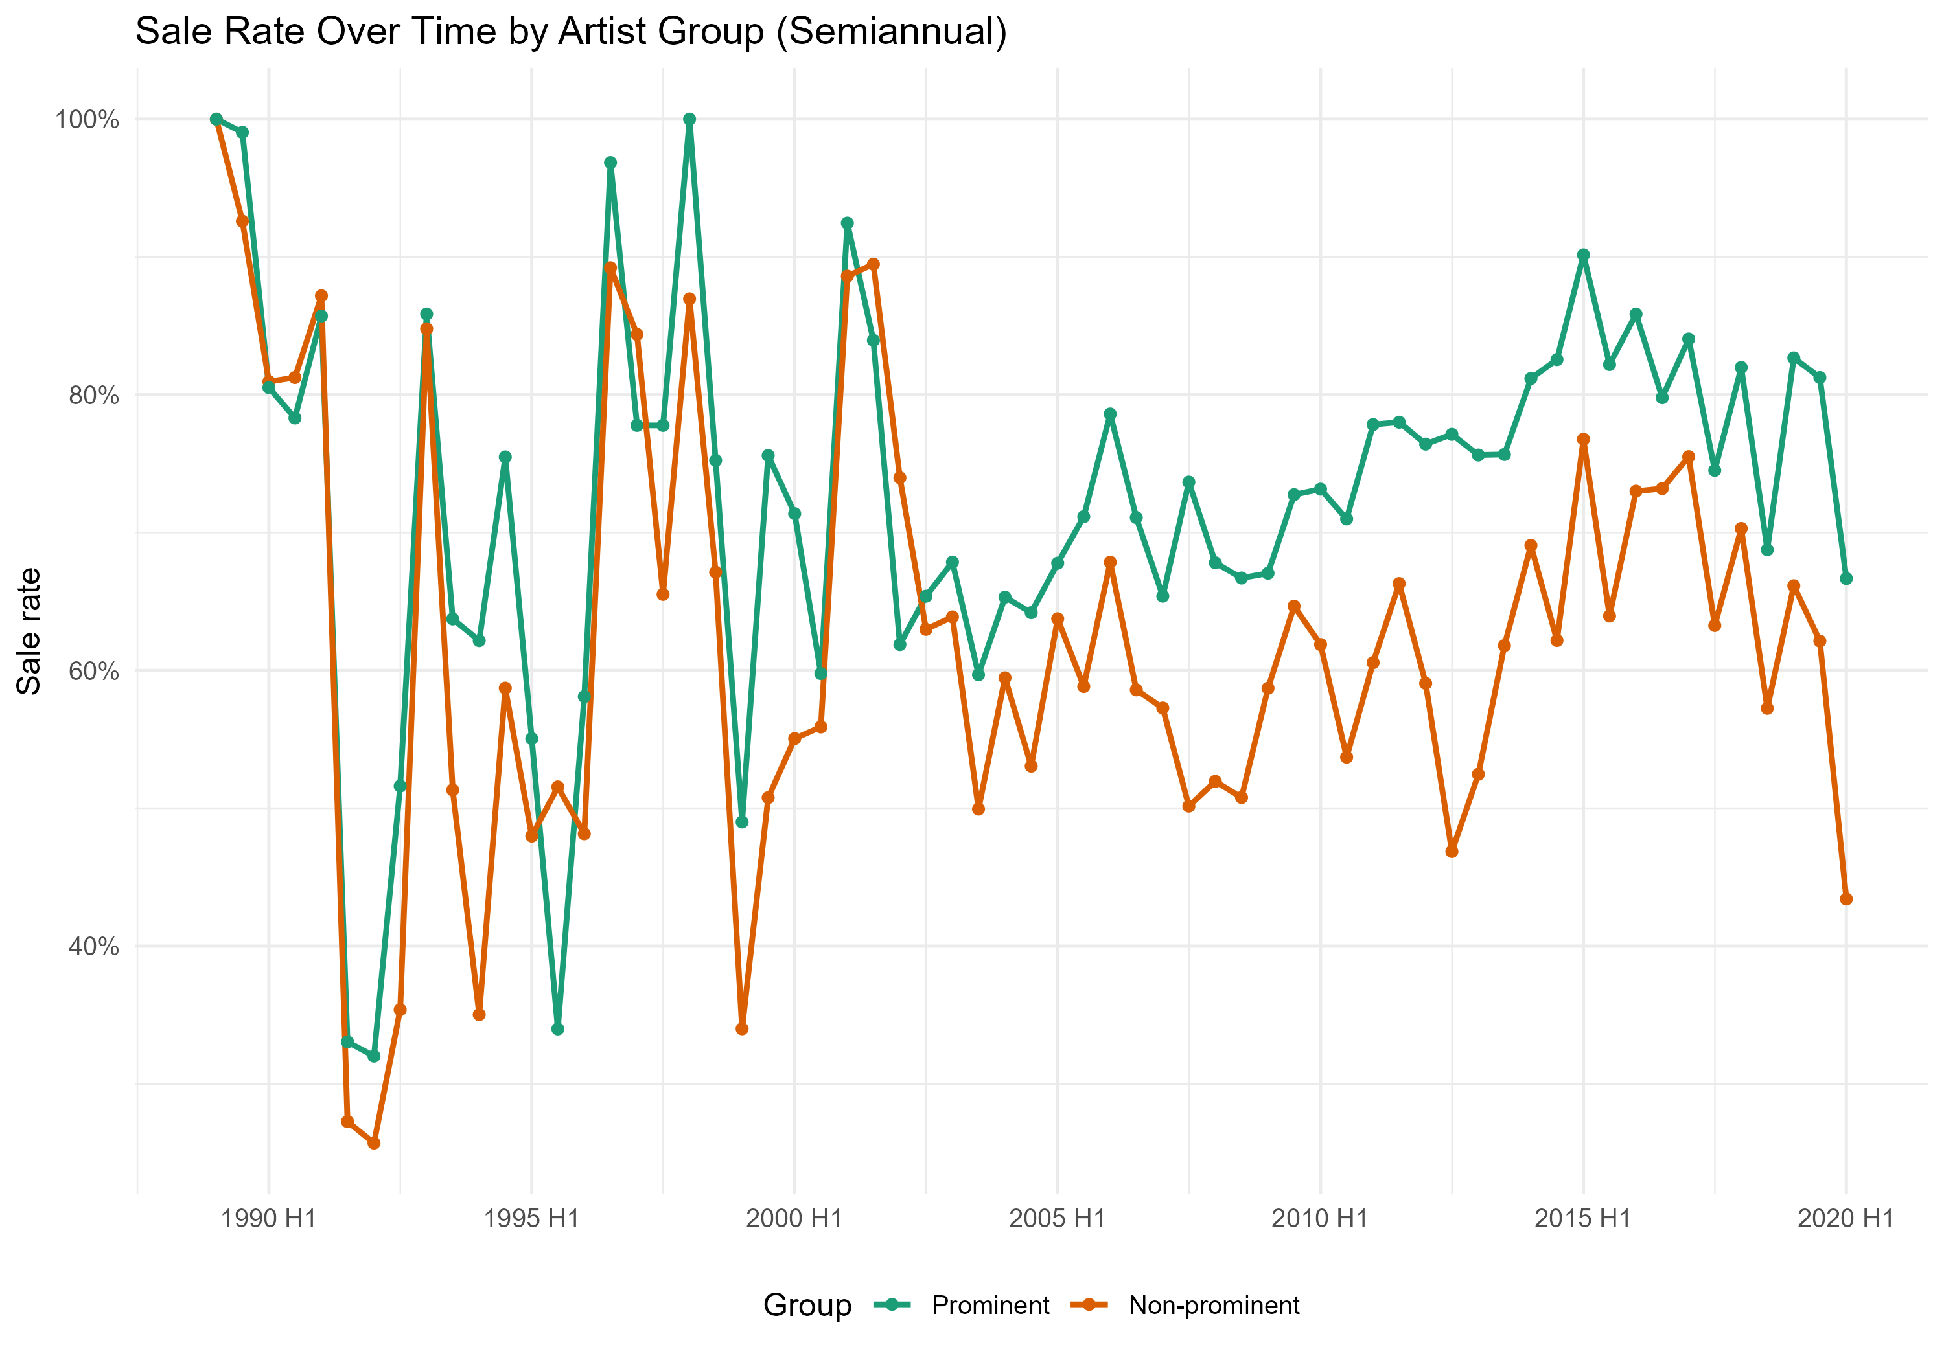
Sale Rate Dynamics Over Time
1989-1995: Both groups swing a lot, minimal gap
1996-2005:
Prominent stabilize at 70%
Non-prominent volatile 50-70%
Gap widens
2006-2020:
Prominent: resilient 70-85%
Non-prominent: trending lower
Gap persists

Slide 11
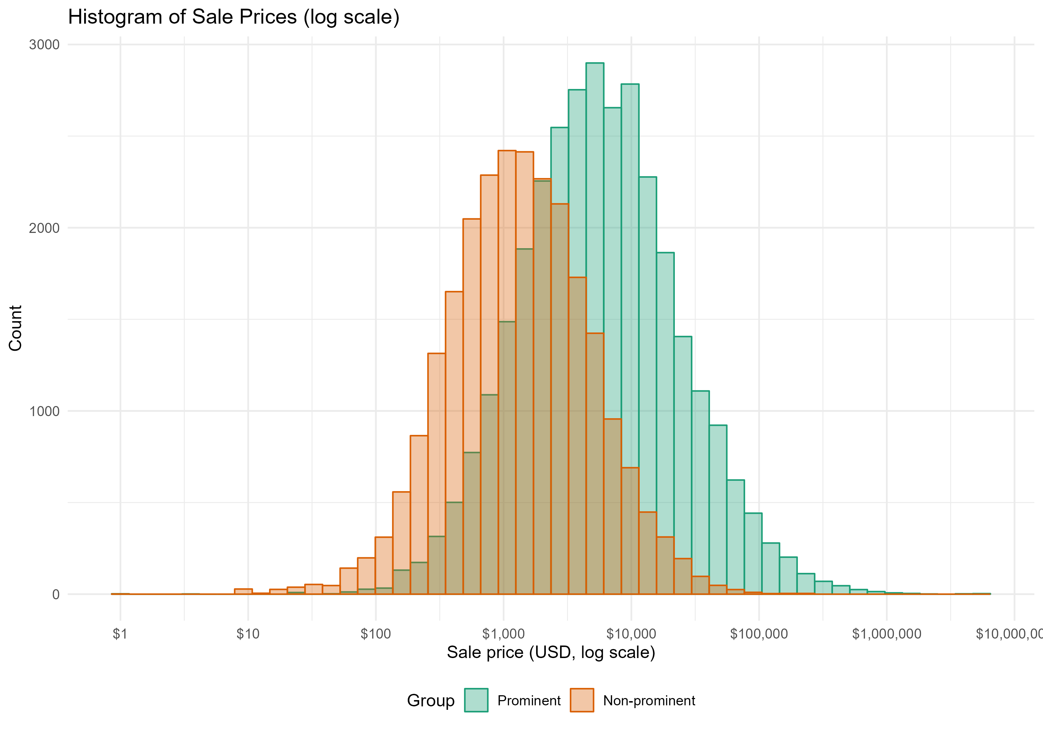
Price Distribution by Artist Segment
Prominent Artists (Teal):
Median: $5,442 Mean: $17412 SD: $75593
Wider price range (P10–P90: $935–$35,714)
Includes masterpieces reaching $5.5M
Non-Prominent (Orange):
Median: $1,311 Mean: $3028 SD: $6669
Narrower absolute range (P10–P90: $271–$6,667)
Few works exceed $50K

Slide 12
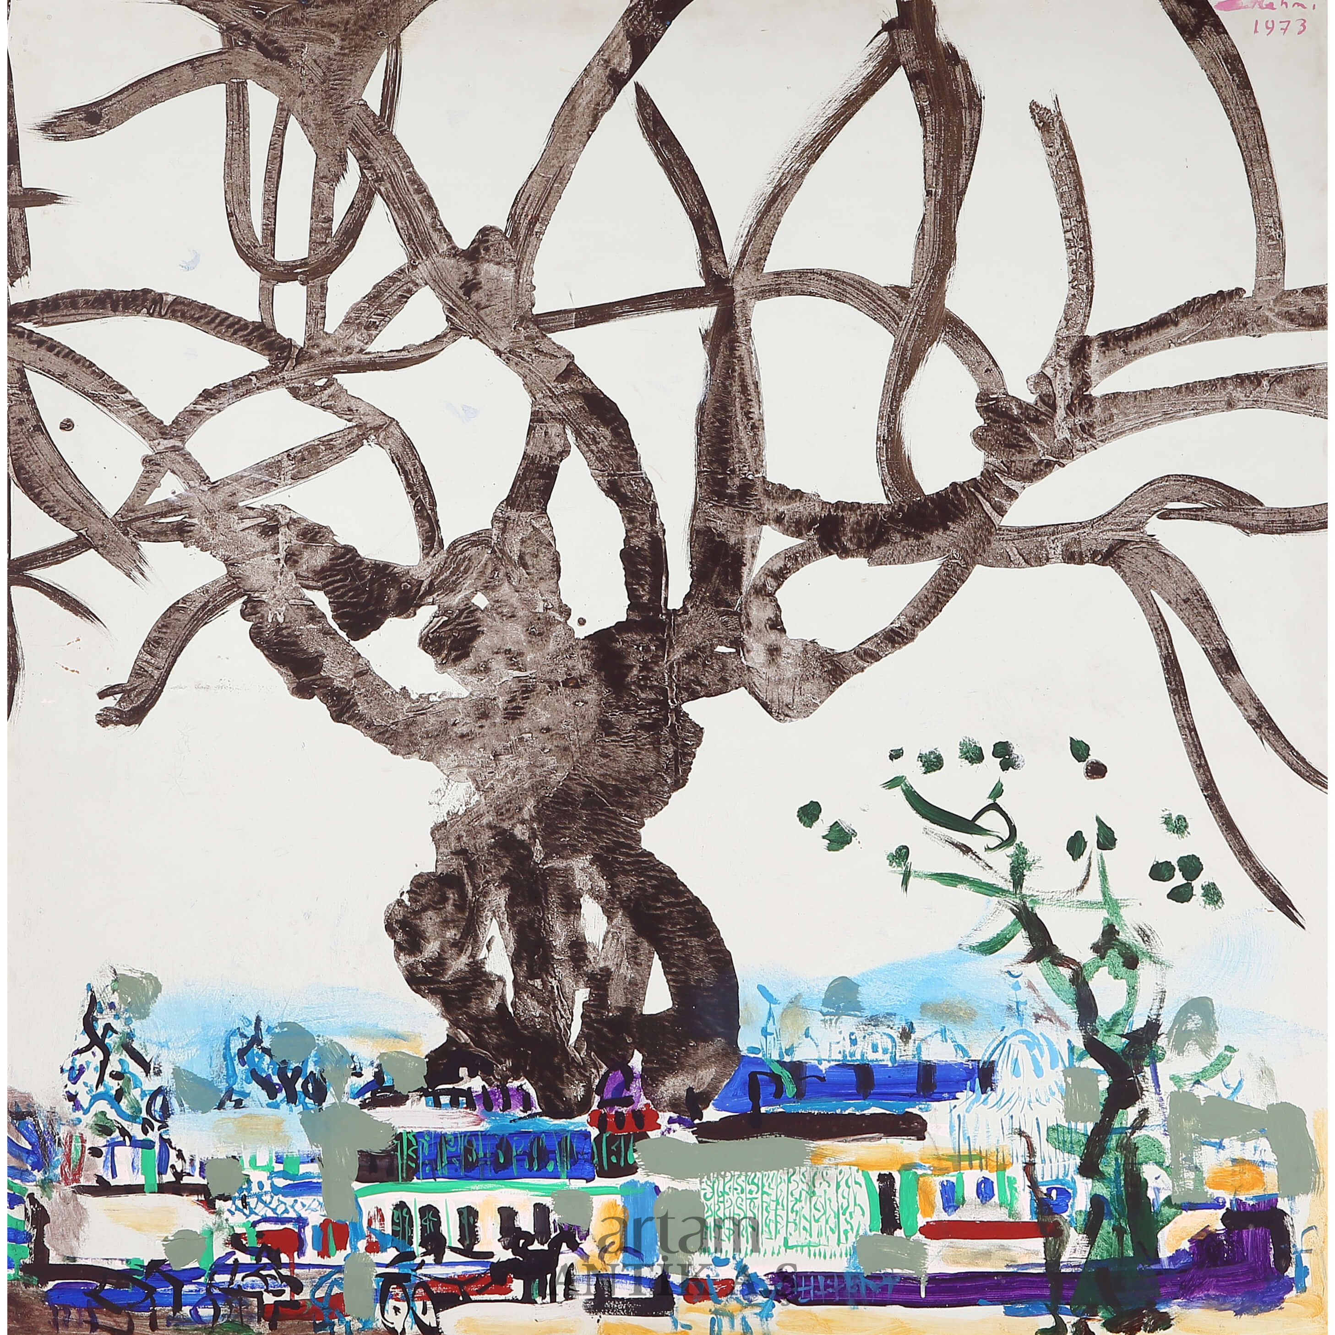
Sale Model

Slide 13
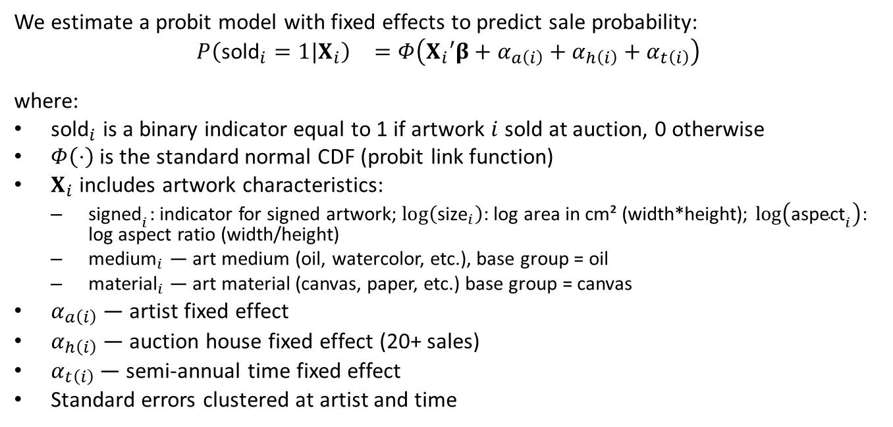
Model Formulation
We estimate a probit model with fixed effects to predict sale probability:
$$\begin{matrix}P\left({\text{sold}}_{i}=1|X_{i}\right) & =Φ\left(X_{i}′β+α_{a\left(i\right)}+α_{h\left(i\right)}+α_{t\left(i\right)}\right) \\ & \end{matrix}$$
where:
${\text{sold}}_{i}$ is a binary indicator equal to 1 if artwork $i$ sold at auction, 0 otherwise
$Φ\left(⋅\right)$ is the standard normal CDF (probit link function)
$X_{i}$ includes artwork characteristics:
${\text{signed}}_{i}$: indicator for signed artwork; $log\left({\text{size}}_{i}\right)$: log area in cm² (width*height); $log\left({\text{aspect}}_{i}\right)$: log aspect ratio (width/height)
${\text{medium}}_{i}$ — art medium (oil, watercolor, etc.), base group = oil
${\text{material}}_{i}$ — art material (canvas, paper, etc.) base group = canvas
$α_{a\left(i\right)}$ — artist fixed effect
$α_{h\left(i\right)}$ — auction house fixed effect (20+ sales)
$α_{t\left(i\right)}$ — semi-annual time fixed effect
Standard errors clustered at artist and time

Slide 14
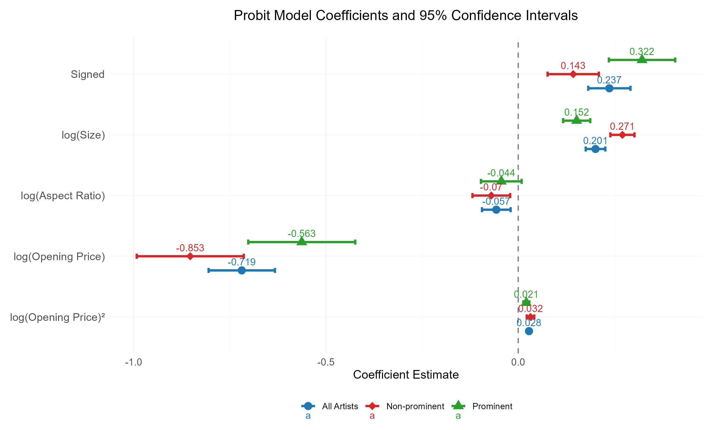
Sale Model Probit Results
Notes:
The key patterns: Signatures boost sale probability, especially for prominent artists. Larger works sell better, particularly in the non-prominent segment. And opening price has a strong negative effect—overpricing kills sales.
Notice the segmented models reveal important differences. The opening price effect is MORE negative for non-prominent works, meaning these buyers are especially price-sensitive. Let’s explore that relationship next.

Slide 15
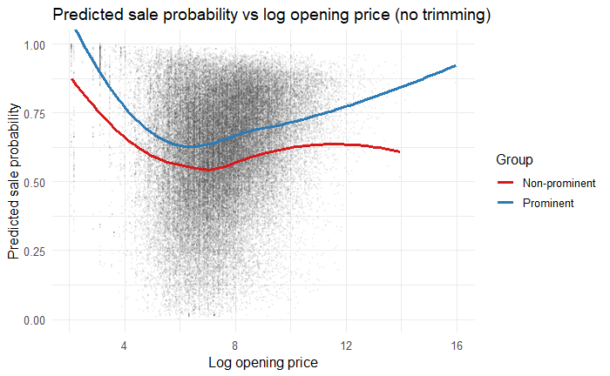
Opening Price vs Sale Probability
Aggressive opening prices filter serious collectors; for non-prominent segment this shrinks the addressable market; for promnent segment, it selects the most committed buyers
Notes:
This shows predicted sale probability versus opening price.
Notice the dramatic difference between segments. For non-prominent works—the red curve—aggressive pricing kills sales. The probability drops from nearly 100% to around 55%. Buyers interpret high reserves as overvaluation.
But for prominent artists—the blue curve—we see something fascinating: at extreme prices, above $150,000, the curve turns upward again. High reserves on masterpieces signal confidence and quality, attracting serious collectors rather than deterring them.
This asymmetry motivates our segmented approach—pricing dynamics are fundamentally different.

Slide 16
Average Marginal Effects on Sale Probability
Variable | All Artists | Prominent | Non-Prominent
Signature | 0.08*** | 0.107*** | 0.048***
log(Size) | 0.06*** | 0.048*** | 0.09***
log(Opening Price) | −0.10*** | -0.071*** | −0.136***
log(Aspect Ratio) | −0.019** | -0.014 | −0.023**
Signature matters most for prominent artists 0.107 or +10.7 percentage points (pp) but matters less for the rest (+4.8pp)
Size matters most for non-prominent artists (+9.0pp)
Opening price is the dominant penalty — especially for non-prominent (−13.6pp per log increase)
A 10% higher opening prices decreases sale probability by approximately 1.4pp for non-prominent segment
Unlike prominent works, non-prominent pieces require modest reserve pricing to ensure sales
Aspect ratio — has a small but significant effect
Medium, material effects, while statistically significant, are economically modest. This suggests buyers prioritize the artistic medium and the artist’s reputation far more than physical durability or presentation format.

Slide 17
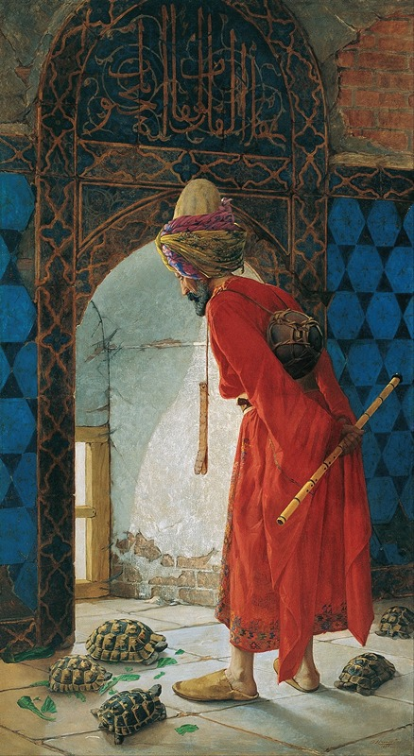
Hedonic Regression Model

Slide 18
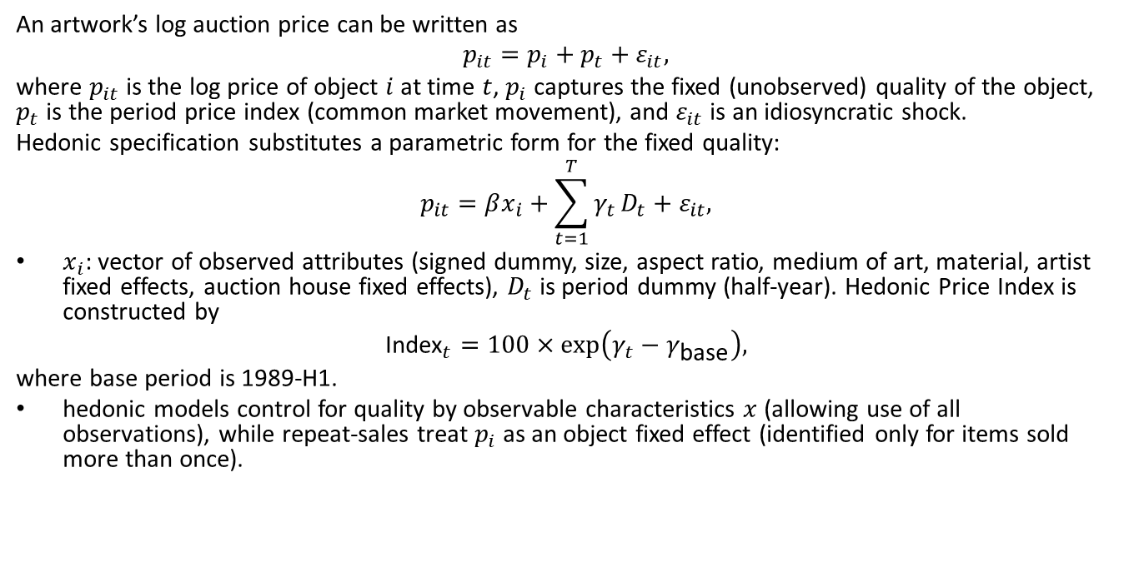
Methodology
An artwork’s log auction price can be written as
$$p_{it}=p_{i}+p_{t}+ε_{it},$$
where $p_{it}$ is the log price of object $i$ at time $t$, $p_{i}$ captures the fixed (unobserved) quality of the object, $p_{t}$ is the period price index (common market movement), and $ε_{it}$ is an idiosyncratic shock.
Hedonic specification substitutes a parametric form for the fixed quality:
$$p_{it}=βx_{i}+\sum_{t=1}^{T}{γ_{t}}D_{t}+ε_{it},$$
$x_{i}$: vector of observed attributes (signed dummy, size, aspect ratio, medium of art, material, artist fixed effects, auction house fixed effects), $D_{t}$ is period dummy (half-year). Hedonic Price Index is constructed by
$${\text{Index}}_{t}=100×exp\left(γ_{t}−γ_{\text{base}}\right),$$
where base period is 1989-H1.
hedonic models control for quality by observable characteristics $x$ (allowing use of all observations), while repeat‑sales treat $p_{i}$ as an object fixed effect (identified only for items sold more than once).

Slide 19
Hedonic regression model estimation results (USD)
(Full results in Appendix Table 1)
Notes:
Key findings:

Slide 20
Hedonic regression model estimation results (TL)
Notes:
Key findings:

Slide 21
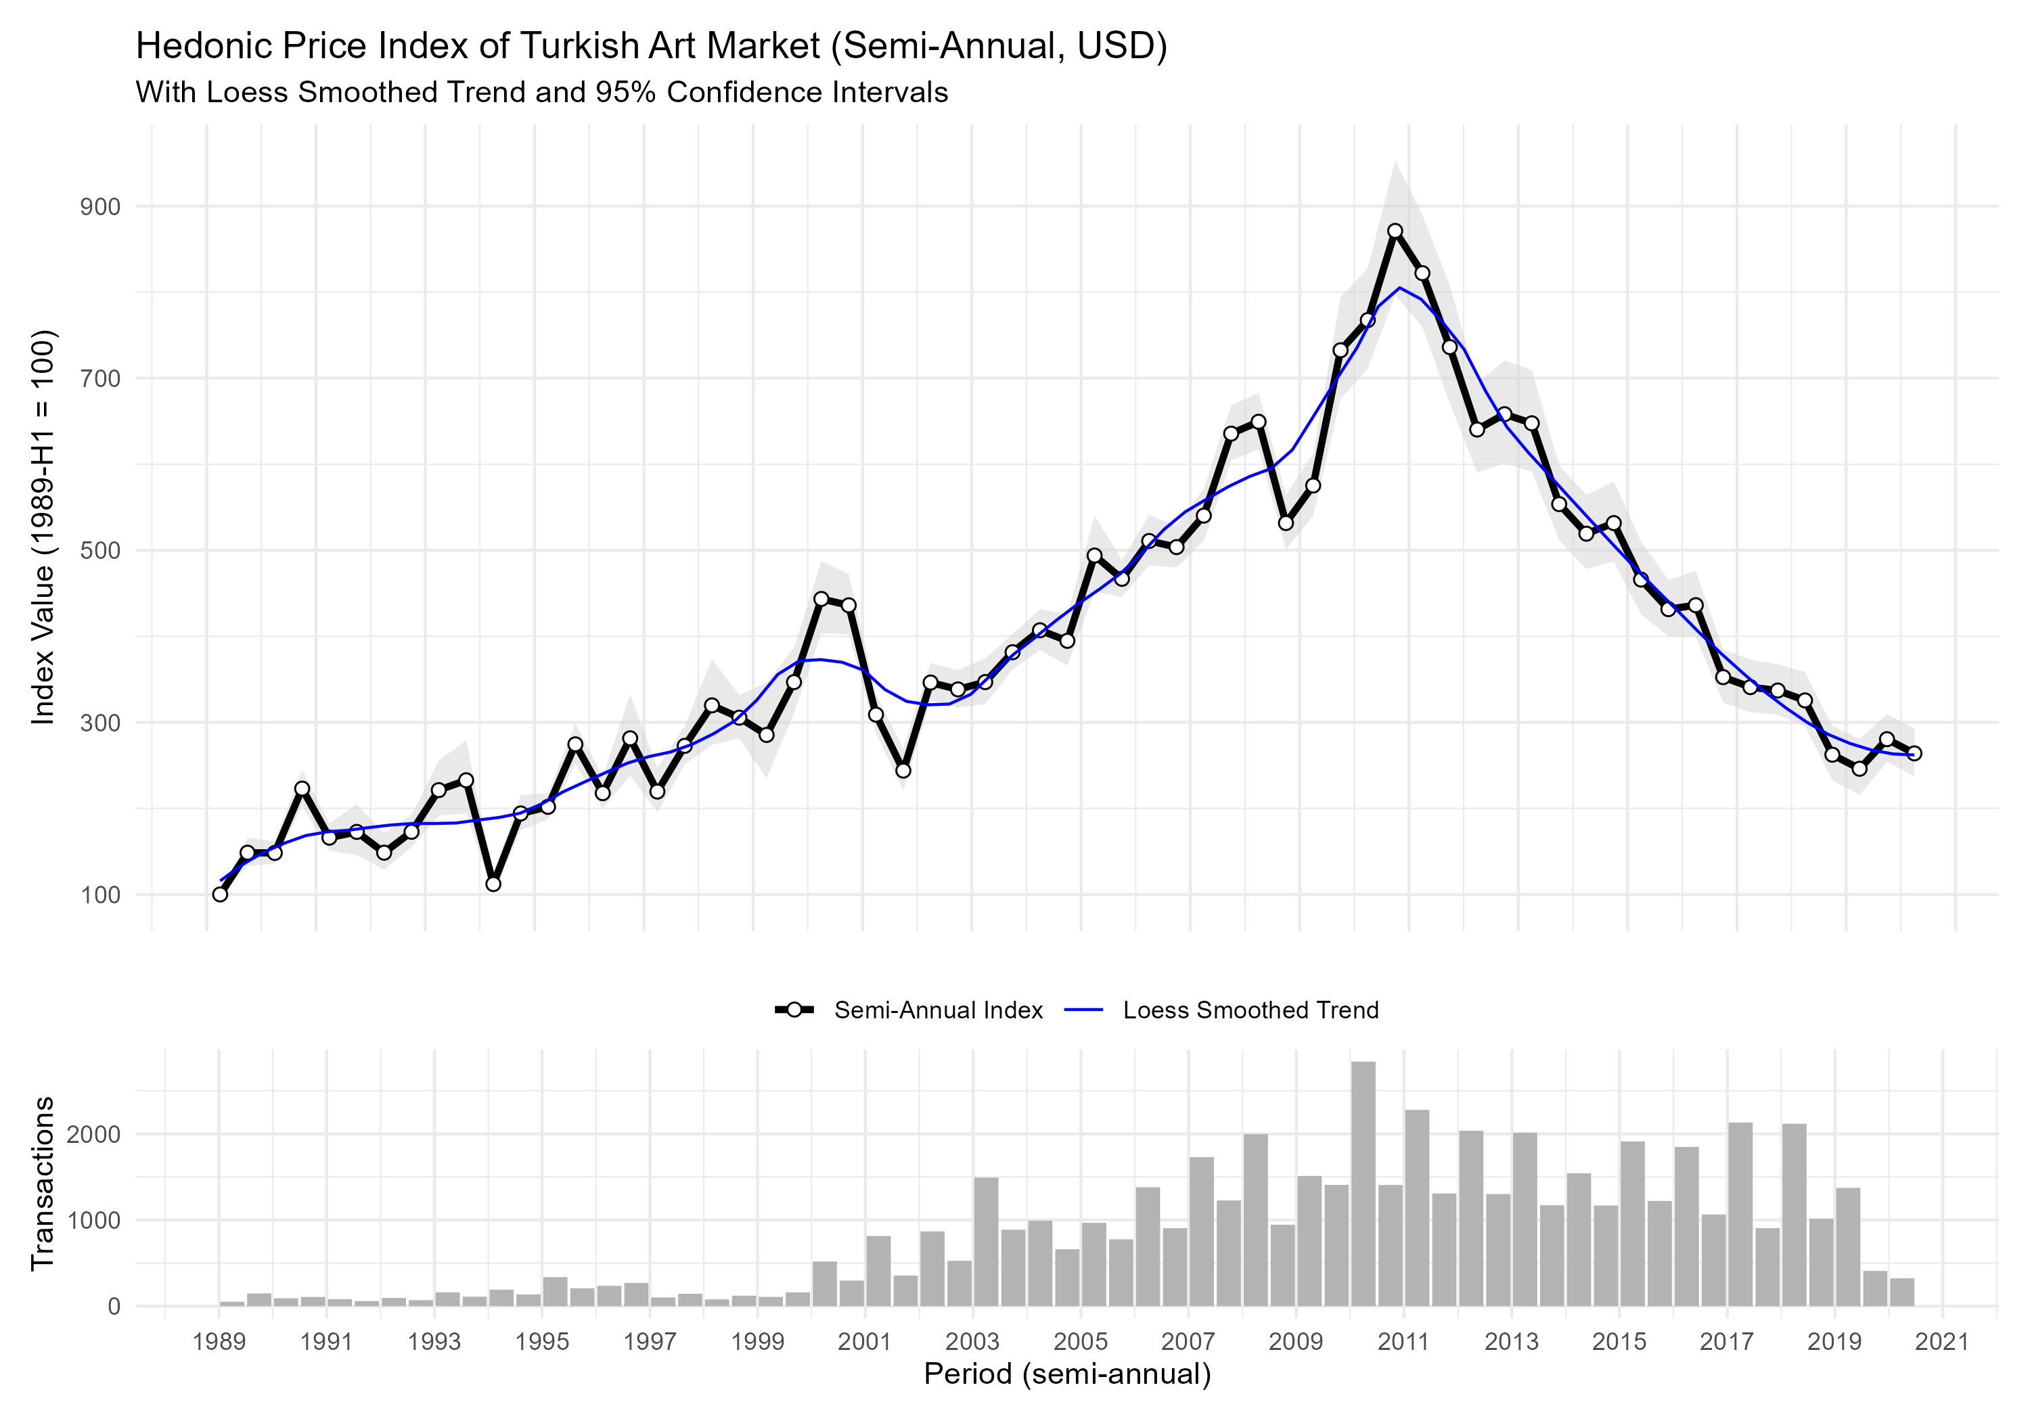
Hedonic price index (in USD, aggregate)

Slide 22
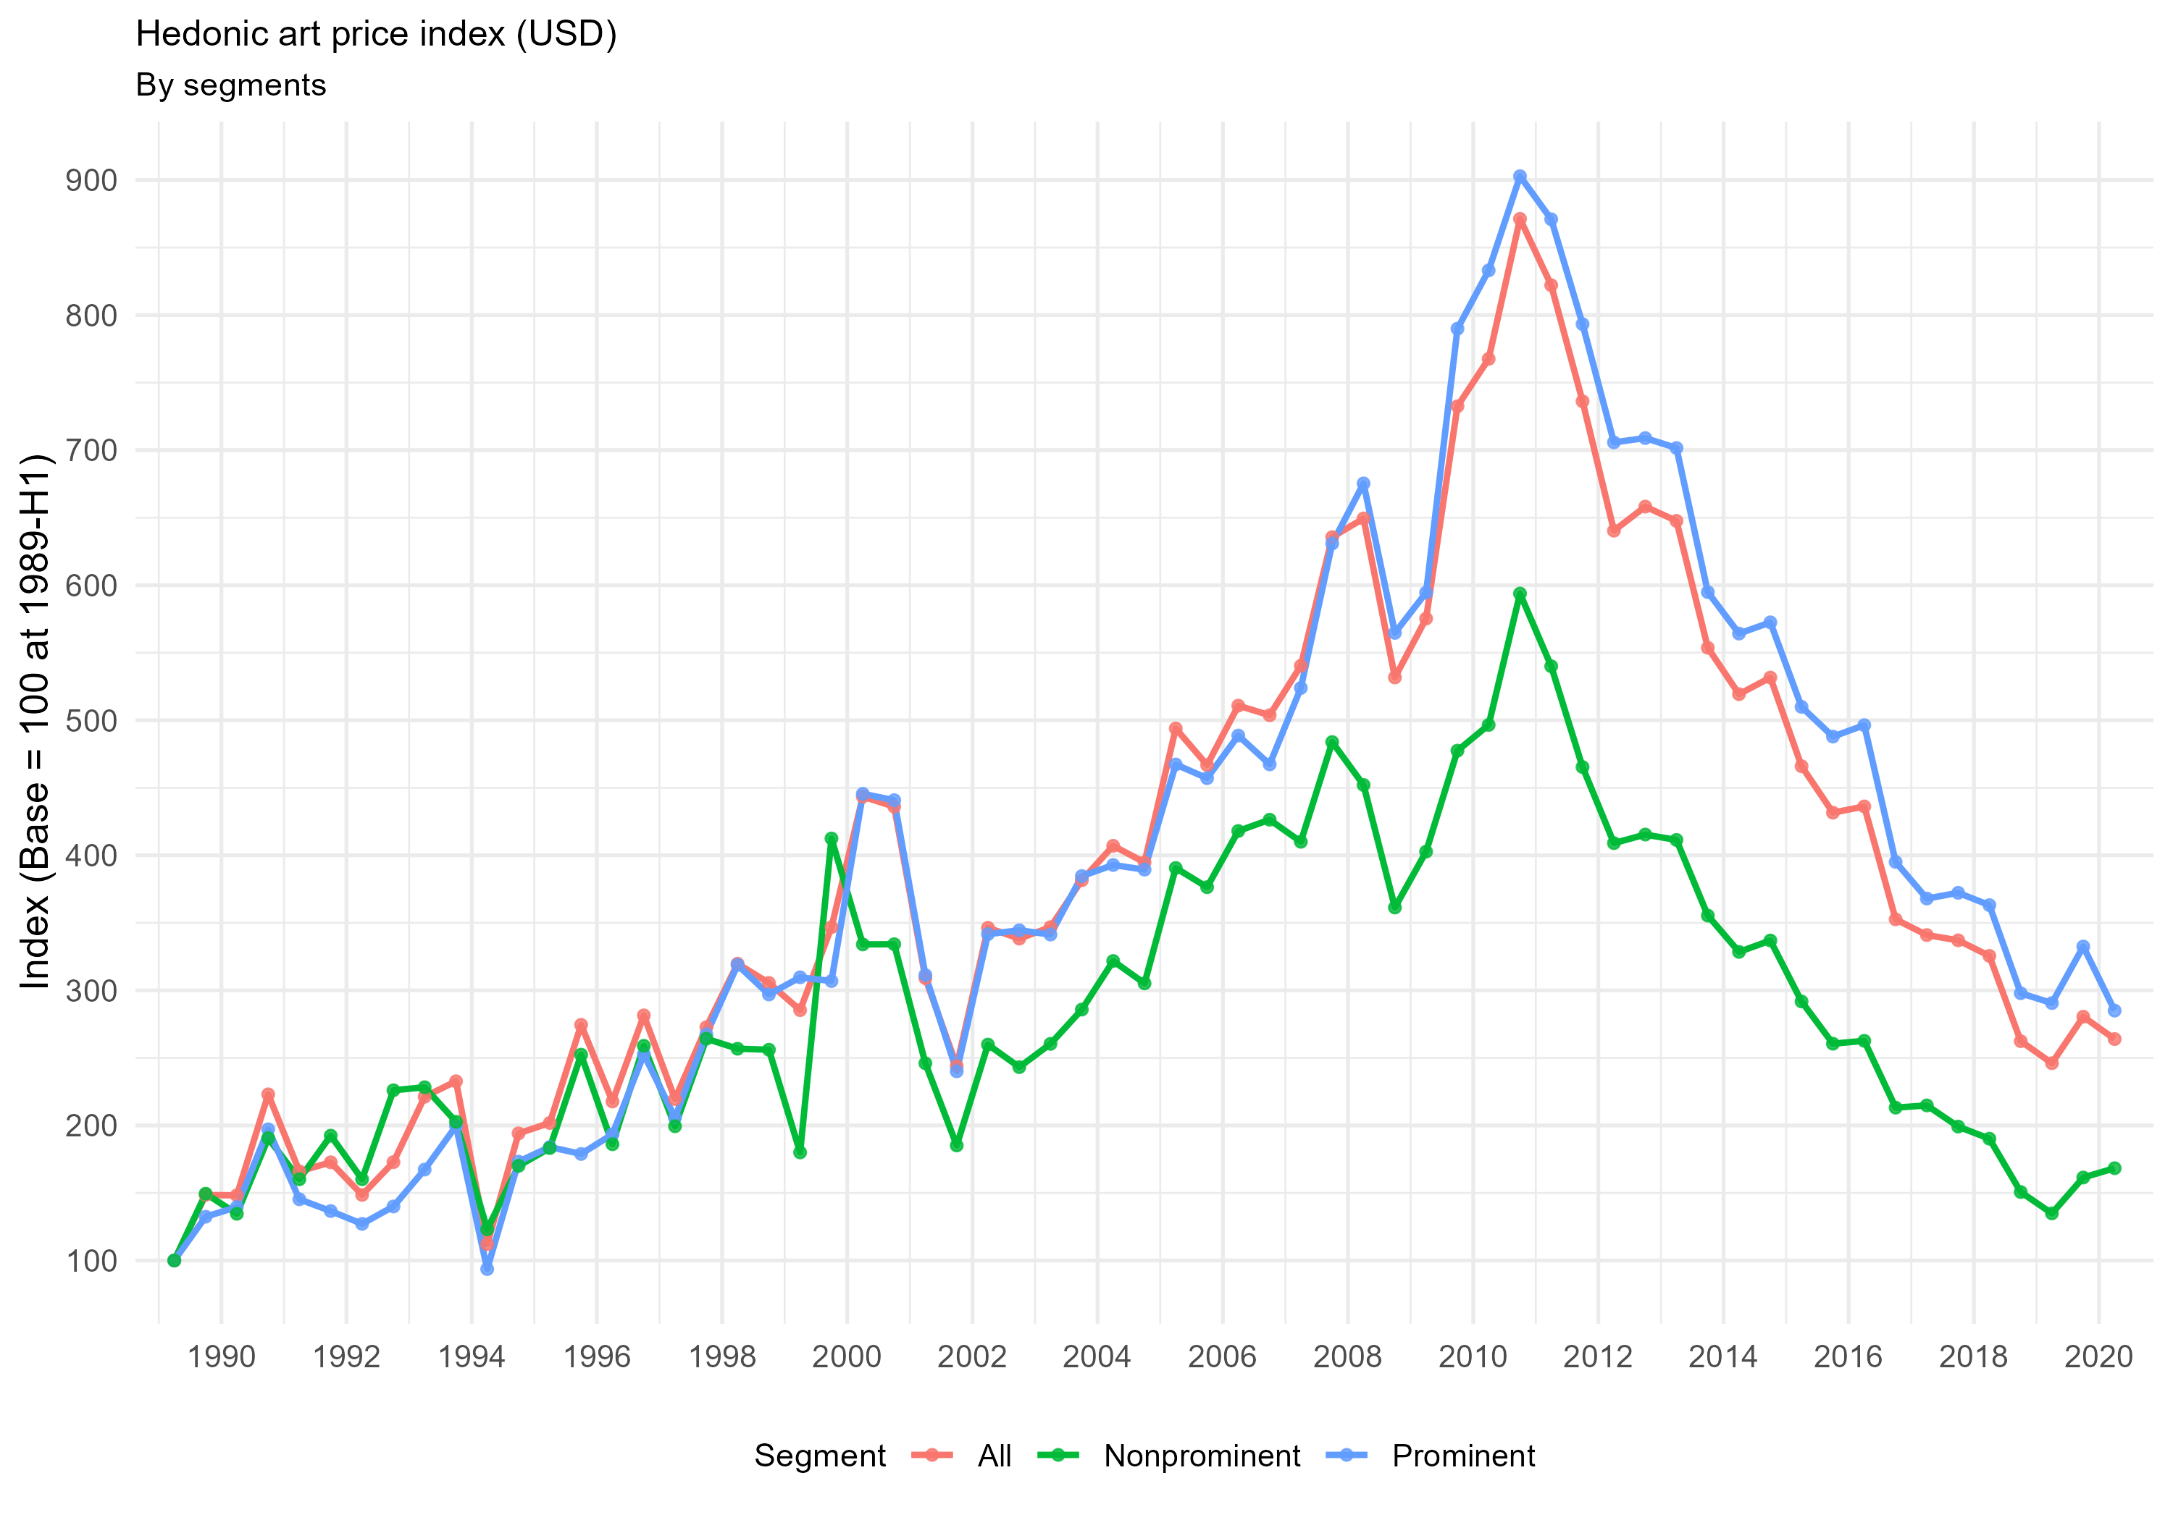
Hedonic price index (in USD, segmented)
Elite/prominent segment consistently above non-prominent especially post-late 1990s
Market driven by elite segment
2× gap by 2020 (prominent: ~250, non-prominent: ~160)
All segments share same trend and cycle
Boom 1989-2011
Bust 2011-2020

Slide 23
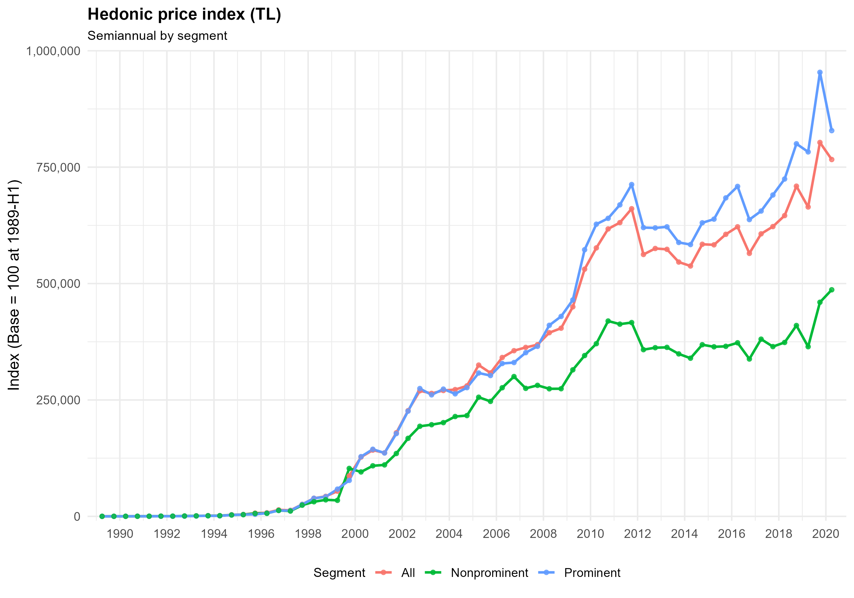
Hedonic price index (in TL, segmented)

Slide 24
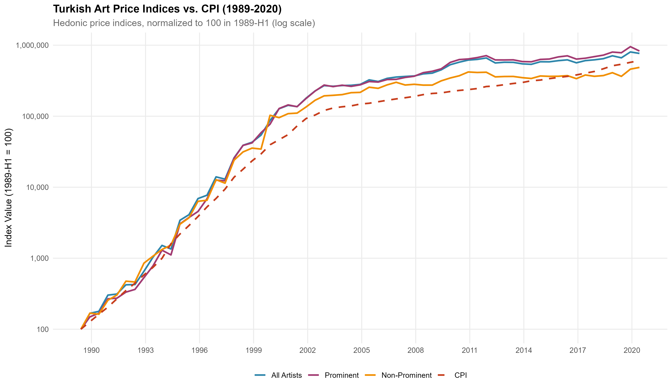
Hedonic price index (in TL, log scale, with CPI)

Slide 25
Turkish Art Market Performance (1989-2020)
Index | Avg Nominal Return | SD Nominal | Avg Real Return | SD Real | Sharpe Ratio
Prominent Artists | 41.7% | 54.3% | 3.0% | 21.5% | 0.14
All Artists | 40.2% | 50.5% | 2.1% | 19.3% | 0.11
Non-Prominent Artists | 38.1% | 50.5% | 0.6% | 20.3% | 0.03
High inflation environment:
Nominal returns 38-42% vs real returns 0.6-3%
Inflation eroded ~95% of nominal gains
Prominent artists outperform:
3% real return vs 0.6% non-prominent
5× better Sharpe ratio (0.14 vs 0.03)
Extreme volatility:
50-54% standard deviation
Much higher than traditional assets
Poor risk-adjusted returns:
All Sharpe ratios near zero
Barely compensated for risk taken

Slide 26
Asset Performance Comparison (1989-2020)
Asset | Nominal Return | Real Return | Volatility | Sharpe
BIST100 📈 | 55.7% ± 105.8% | 13.1% ± 59.8% | Extreme | 0.22
Gold 🥇 | 40.2% ± 37.7% | 4.1% ± 17.1% | Moderate | 0.24
Prominent Artists 🎨 | 41.7% ± 54.3% | 3.0% ± 21.5% | High | 0.14
All Artists 🎨 | 40.2% ± 50.5% | 2.1% ± 19.3% | High | 0.11
Housing 🏠 | 11.5% ± 4.9% | 1.2% ± 6.3% | Low | 0.19
Non-Prominent 🎨 | 38.1% ± 50.5% | 0.6% ± 20.3% | High | 0.03
Best Risk-Adjusted 🏆
Gold (0.24)
BIST100 (0.22)
Housing (0.19)
Worst Performers 📉
Prominent Art (0.14)
All Art (0.11)
Non-Prominent Art (0.03)
Prominent art had decent raw returns, but achieved them through extreme volatility. When you account for risk, it falls behind even housing.
Notes:
Let me compare Turkish art to traditional assets.
The table shows six assets ranked by Sharpe ratio on the right. Gold and stocks take the top two spots with Sharpe ratios above 0.20. Housing ranks third at 0.19 despite modest returns—its low volatility pays off.
All three art categories fall to the bottom. Prominent art is particularly interesting: it achieved a respectable 3% real return—third among these assets—but its extreme volatility drops it to fourth when risk-adjusted, overtaken by housing.
The gap is substantial: art underperforms traditional assets by 40-85% in risk-adjusted terms.

Slide 27
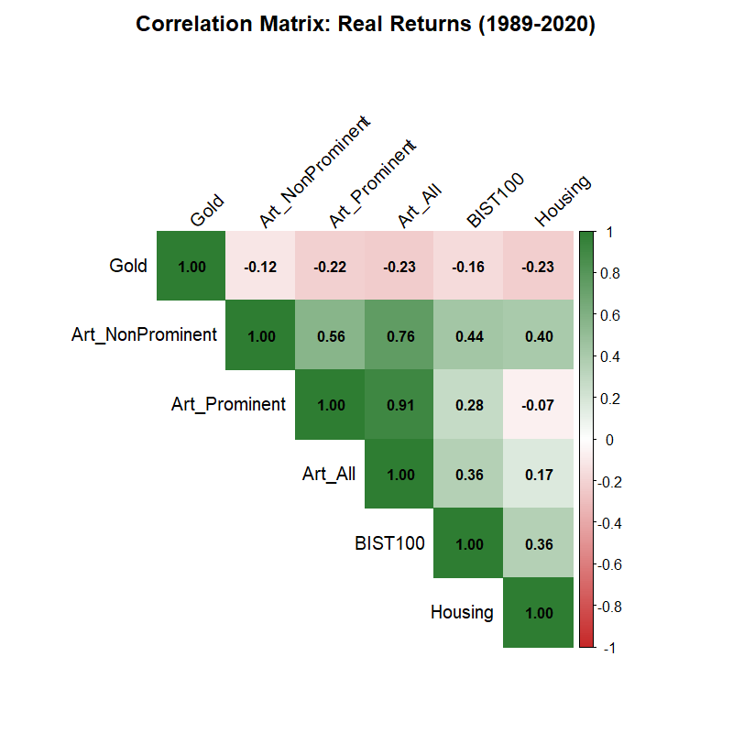
Correlations
Art segments move together
Limited diversification within the art market
When prominent art falls, all art tends to fall
Mixing artist tiers doesn’t reduce risk significantly
Weak Negative Correlation with Gold: suggests diversification benefit
Weak-moderate positive correlation with stocks (0.36): limited diversification benefit

Slide 28
Conclusion
Turkish paintings as a Consumption Good, Not an Investment
Investment Performance
Real returns: 0.6-3% annually (1989-2020)
Sharpe ratios: 0.03-0.14 (art) vs. 0.19-0.24 (gold/stocks/housing)
Art underperforms traditional assets by 40-85% in risk-adjusted terms
High inflation eroded ~95% of nominal gains
Market Mechanism
Strong heterogeneity based on artist prominence
Sale probability dominated by signature (+8-11pp) and reserve pricing (-7 to -14pp)
Non-prominent art shows high sensitivity to opening price (-13.6pp per log increase)
Investment Implications
✗ Poor risk-adjusted returns make art unsuitable as core investment
✓ Modest diversification benefit (negative correlation with gold, low correlation with stocks)
✓ Small allocation (<5%) justified only for consumption value and expert collectors
→ However, better alternatives exist (gold/stocks) for risk-adjusted returns
Notes:
Let me conclude with three key takeaways. [Pause]
First, on investment performance: Turkish art delivered real returns of just 0.6 to 3% annually from 1989 to 2020. Sharpe ratios ranged from 0.03 to 0.14—far below gold, stocks, and even housing. Art underperforms traditional assets by 40 to 85% on a risk-adjusted basis. High inflation eroded about 95% of nominal gains.
Second, on market mechanism: we found strong heterogeneity based on artist prominence. Sale probability is dominated by signature presence and reserve pricing. Non-prominent art shows extreme price sensitivity to opening prices.
Third, investment implications: poor risk-adjusted returns make art unsuitable as a core investment. Diversification benefits are limited. A small allocation—under 5%—might be justified for consumption value or expert collectors, but for pure investment, gold and stocks are superior.
Thank you. I’m happy to take questions.

